Slide 1
Introduction to the safe dental environment, patient interview
DENT1060: Dental Practice IA

Slide 2
The safe dental environment Establishing the baseline for Dentistry

Slide 3
Learning objectives
Identify risks associated with dental practice
Define standard precautions and how they translate to the safe practice of dentistry
Describe the process for and rationale underpinning standard precautions & infection control processes

Slide 4
What risks are present in the dental environment?
Cross-infection from contaminated hands due to poor compliance with hand hygiene
• Exposure to blood/body fluids (saliva, blood, vomitus).
• Exposure to, and or acquisition of a vaccine preventable disease (hepatitis B, viral influenza, TB, etc).
• Cross infection due to poor compliance with cleaning of patient care equipment and/or the
environment.
• Cross-infection due to treatment of patients/clients with symptoms of communicable diseases, e.g.
Influenza, measles and chicken pox.
• Cross-infection due to incorrect or inappropriate cleaning, disinfection or sterilisation of reuseable
medical devices or the re-use of medical devices marked as single-use only.
• Preventable patient or staff harm due to the absence of an infection prevention program.
• Non-compliance with established policies/procedures resulting in a preventable infection.

Slide 5
Infection control
Definition:
The creation of safe healthcare environments through the implementation of evidence-based
practices that minimise the risk of transmission of infectious agents (NHMRC, 2019).
What does this mean?
To prevent and to minimise the transmission of disease-producing agents
Bacteria
Virus
fungi
To prevent and to minimise this transmission between:
Dentist/staff to patients
Patients to dentist/staff

Slide 6
Requirements for transmission of infection
Transmission of infectious agents within a healthcare setting requires all of the following elements:
1. Causative agent (pathogen)
2. Reservoir
3. Portal of exit
4. Means of transmission
5. Portal of entry
6. A susceptible host
(NHMRC, 2019)

Slide 7
Pathways for transmission
Contact transmission
Direct or indirect transmission by touch/contact with bodily substances
Direct -> infectious agent is transferred from one individual to another (eg patient’s blood invades a practitioner’s open wound)
Indirect -> infectious agent is transferred through contaminated object/person (eg handshake and direct contact of your hand to your mouth/wound)
Droplet transmission
Transmission of infectious agent via respiratory droplets from an infected individual (eg coughing)
Airborne transmission
Transmission of infectious agents via particles that remain infectious over time and distance (eg aerosol generation from dental equipment)

Slide 8
So what exactly do we do for infection control?
The spread of microorganisms can be reduced by:
• Adhering to good personal hygiene practices, particularly effective hand hygiene and cough etiquette
• Using PPE correctly
• Limiting surface contamination by microorganisms (e.g. disinfecting chairs, equipment, tables)
• Using disposable products where appropriate (e.g., paper towels); and
• Following risk minimisation techniques such as the use of high-volume evacuation, dental dam and pre-procedural mouth rinsing.
(Australian Dental Association, 2021)
Failure to comply with the Dental Board’s guidelines may lead to an investigation by a public health regulator
There is a risk of license restriction or suspension!

Slide 9
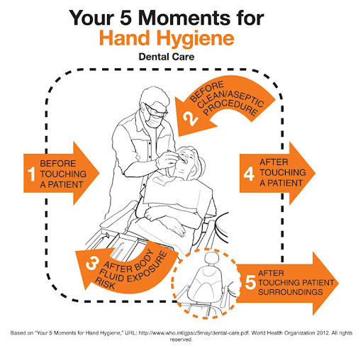
*Hand hygiene
Important rules in cleanliness
Bare below elbows
Proper maintenance and moisturisation of skin
Laceration/cracked skin allow entry of microorganisms
Open wounds require fluid-proof dressing
When are the 5 moments?
Before seeing the patient
During treatment (sterile treatment)
After exposure to bodily fluids
After discharging the patient
After touching surroundings before disinfection

Slide 10
*Personal Protective Equipment (PPE)
Gloves
For ALL clinical procedures, especially when coming into contact with mucous membranes
Mask
Protects the mucous membranes of the nose and mouth against aerosols, splashes
Eye Protection
Protection of mucous membranes of the eyes against aerosols, splatter of blood or saliva
Prescription glasses do not replace eye protective wear, however prescription can be added into some eye protective wear
Protective clothing
Protective gown/surgical gown, protective coats -> remove before leaving clinic premises
If daily scrubs are to be worn -> another layer of protective clothing on top to minimise contamination

Slide 11
Sterilisation vs Disinfection
Sterilisation: process of rendering an item free of all forms of viable micro-organisms, including spores
The most efficient and simplest method of sterilising equipment is pressurised steam process
Known as autoclaving (TGA approved & operated according to AS/NZS 4187 and/or AS/NZS4815)
As side a note: even autoclaving cannot achieve full sterilisation, but it does remove microbial load to an acceptable level to be labelled as “sterilised”
Disinfection: process of using chemicals to kill microorganisms on surfaces
This process in itself does not necessarily fully kill all microorganisms or remove them/broken down by products from the surfaces
Reduces the microbial load less than the sterilisation process
Why do we need to know the difference?
Notes:
We need to know the difference because:
We want to know when sterilization or disinfection is more appropriate for certain equipment.
We want to know if sterilization is possible in a patient. But is that possible?

Slide 12
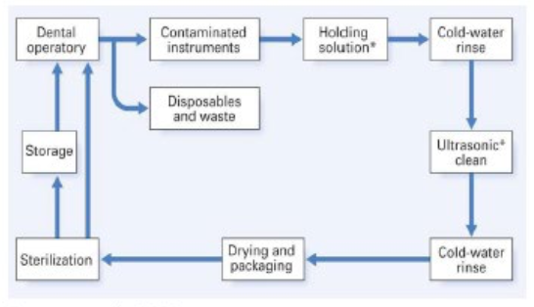
Process of sterilisation in Dentistry
Preparation (PPE)
Cleaning (detergent solution)
Rinsing
Drying (lint free towels)
Packaging (steri pouch)
Sterilisation
Storage
Documentation

Slide 13
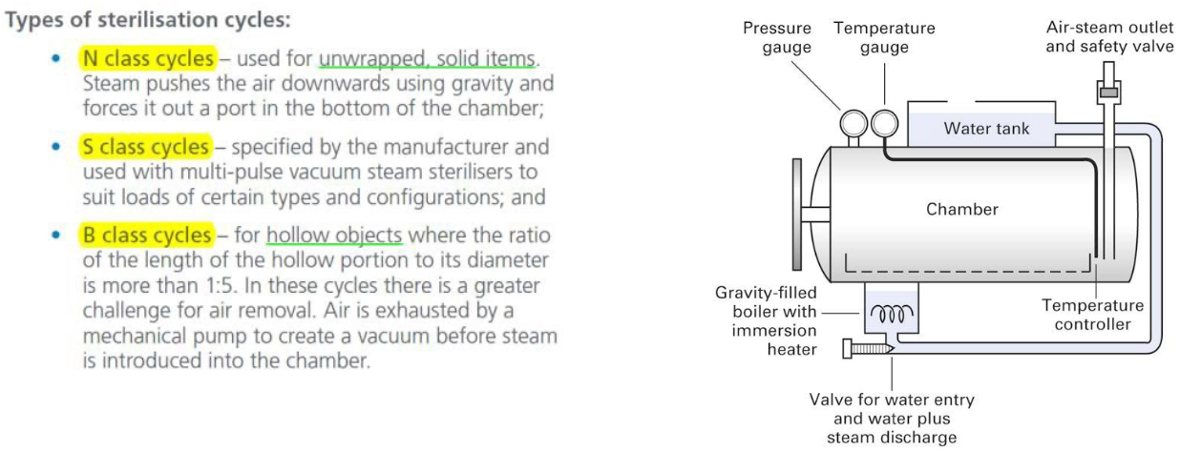
Autoclave machine

Slide 14
Maintenance and testing
As alluded to in prior slides, as we are a healthcare profession, we are regulated by standard that we need to uphold when:
Investigating the patient
Performing treatment
Maintaining/cleaning equipment
Autoclaves are subject to:
TGA approval for the machine to be allowed to be sold and used in Australia
Operated according to standards (Helix test and Bowie-Dick test)
Undergo process of validation upon installation (similar with other equipment such as the xray machine)
Regular inspection and performance testing to ensure it is still to standard
All cycles of autoclaving must have have batch control identification

Slide 15
Dental unit waterline (DUWL)
The dental unit waterline is a component in the dental chair where water may remain stagnant -> fosters microbial growth!
The growth of microbes are counted in Colony Forming Units (CFU)/mL
The growth of these microbes can then be produces as aerosols into the patients
Microbes can still grow in flowing dental unit waterline if the water flows slowly!
CFU requirements for different types of water
Surgical procedures -> sterile (0 CFU/mL)
External water (piped water) -> 20~50 CFU/mL
Dent unit handpiece -> <200 CFU/mL
Drink cup water -> potable water (<500CFU/mL)
Notes:
Now this isn’t the correct way to explain water flow as water flow dynamics has a central and peripheral drag component, but the purposes of learning in dental school is to establish a wide understanding of all topics, so we won’t go into specifics.
You may have read if you ever looked at the water pipes in car parks or emergency water supplies, they say “non-potable water, unsafe to drink”, that’s what potable is referring to, the CFU count.

Slide 16
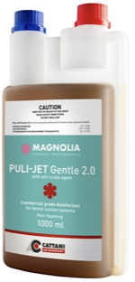
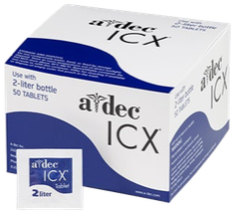
Managing the waterline
Some older dental chairs have been found with 100,000 to 1million CFU/mL in the past…
All equipment that supplies water into the oral cavity must be fitted with non-return valves
If the chair uses a separate bottled water supply -> chemical disinfection of water (or use sterile water if available) for the dental unit
Minimum 2 minutes of air + waterlines flush at beginning of day
30seconds between patients
End of day (or end of week depending on chemical) chemical cleansing of suction lines

Slide 17
Why does this matter?
Just within a normal dental chair, the CFU/mL can fluctuate between 0~80,000, with an average of 9,500
Patients can be exposed to various microbes:
Pseudomonas aeruginosa (survives soap cleaning)
Legionella organisms (immunocompromised and smokers at great risk)
Eschericia Coli, and others
You don’t want to be the responsible clinician if your immunocompromised patient becomes sick

Slide 18
A word for warning for your career
Do ∫NOT underestimate the weakness of an immunocompromised (IC) patient
Every single disease exists in a spectrum of severity
Eg think about when you have a cold…
The severity of your cold symptoms doesn’t run at 100% for the entire duration of your sickness
One IC patient’s system will not be at the same level as another
A single patient’s immunity itself can also have times where it is lower than another day
IE, an “immunocompromised” patient and an IMMUNOCOMPROMISED patient will tolerate different levels of exposure
Don’t draw an assumption just because that one IC patient you’ve seen “was fine”

Slide 19
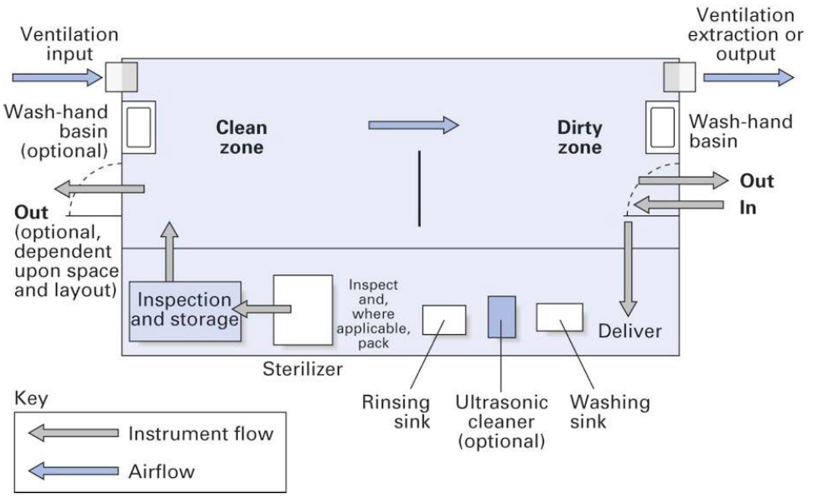
Sterile vs non-sterile (treatment room)
Although the treatment room in itself is to be considered contaminated, it is still important to identify which areas in the room are relatively more clean to appropriate distinguish clean and dirty items (and where they can be placed

Slide 20
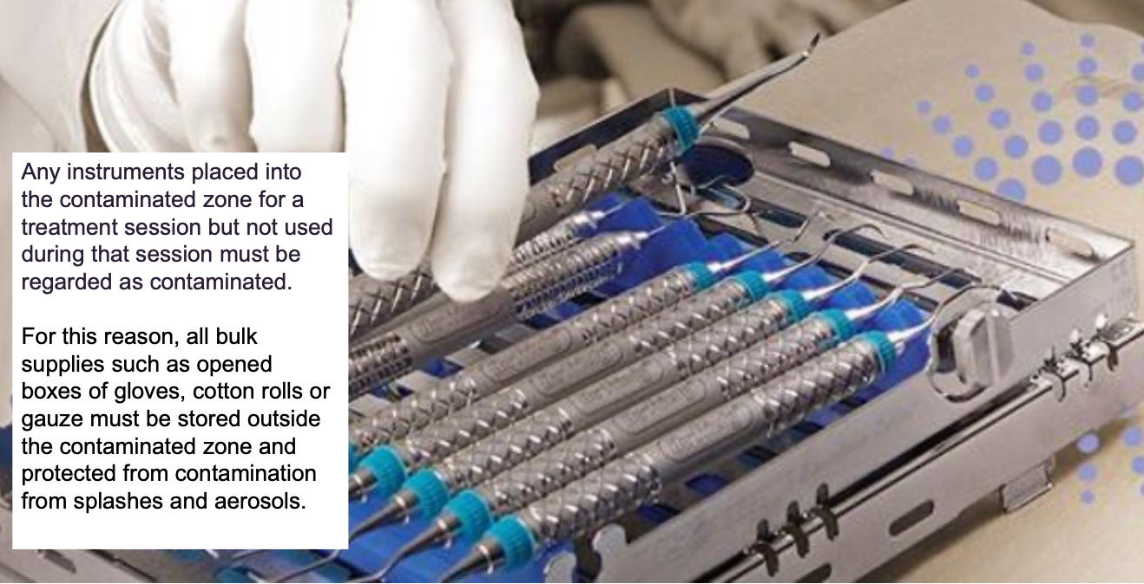
Sterile vs non-sterile (equipment)

Slide 21
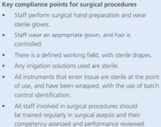
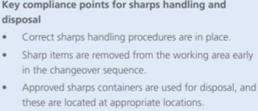
Introduction to sharps management in surgical procedures

Slide 22
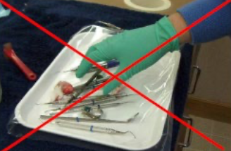
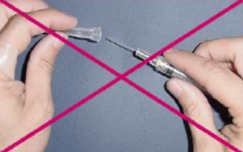
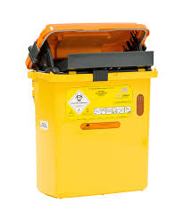
Introduction to sharps management in surgical procedures
Do not!
Pass around sharps unless sharps component is protected/removed
Resheathe needles/sharps unless with proper recapping device/appropriate handling technique
Leave sharps exposed and unattended (resheathed appropriately or transported to sterilising room to be binned into sharps waste bin

Slide 23
Delegation and responsibilities
It is the clinician’s responsibility to ensure that:
Equipment is properly sterilised
Sharps are appropriately handled and disposed of
All attending staff also involved with the patient have appropriately disinfected/protected themselves
It is common for private dental practices to delegate this task to staff and trained nurses/assistants
This does not make the responsibility transfer to them
The clinician who last handles the equipment and onto the patient becomes responsible!!!

Slide 24
The Dental environment
The premises of the clinic Is usually divided into distinct zones
Office areas (clean zone)
Reception
Staff room
Waiting room, and etc
Contaminated areas
Sterilisation room
Treatment rooms
Treatment room
The treatment room is further divided into its relative clean and dirty zones

Slide 25
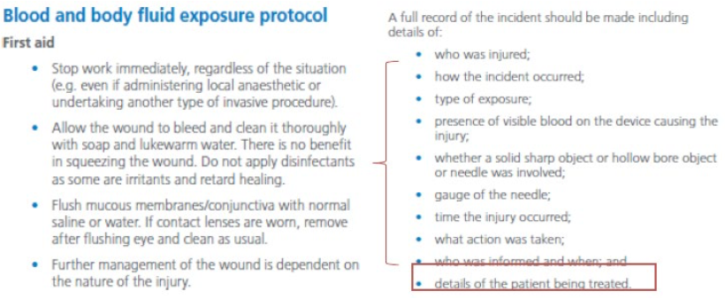
Exposure incident
Any incidents where a contaminated or possibly contaminated object/substance breaches the skin or mucous membrane (including contact with eyes)
Eg blood/saliva contaminated dental instrument “pokes” the skin of practitioner
All incidents must be reported and tracked

Slide 26
Mandatory testing for exposure incidents
Baseline blood test of PATIENT (source) and injured person (staff)
Ideally same day of injury
If pt declines blood test, unfortunately you can only investigate the injured person
Follow up review blood test
3month if HIV
6month if Hepatitis B or C
If there is a high risk category for infectious transfer, may need referral to infectious disease physician

Slide 27
My patient is positive for Hep B/C or HIV
Your duty of care as a practitioner means that you cannot discriminately prioritise or “choose” which patients to see
All patients must be treated the same, unless there is a genuine medical/legal/personal factor that may compromise an unbiased care to the patient
If you sustain a sharps injury:
Follow the usual mandatory incident report protocol
Seek counselling or further advice from the GP if you need

Slide 28
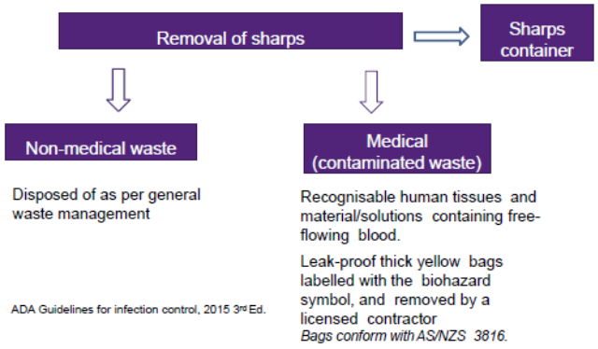
Clinical waste management
Domestic waste vs medical (contaminated) waste
Domestic waste is treated as general waste
Medical waste may be placed through an incineration process
IE: contaminated waste and clinical waste must be binned appropriately
Any extracted teeth must be cleaned of visible:
Blood/saliva
Debris
Soft tissues
Extracted teeth can be disposed of in domestic waste once cleaned
Teeth that contain amalgam restorations (grey filling) may be illegal to incinerate in some states!
Cannot bin in medical waste

Slide 29
Ergonomics

Slide 30
Learning objectives
Identify musculoskeletal risks associated with the practice of Dentistry
Demonstrate correct ergonomics to reduce work-related musculoskeletal injuries
Identify additional strategies to promote ergonomic practice of Dentistry

Slide 31
What is ergonomics?
Ergonomics is an applied science of the “fit” between the practitioner and their technological tools or environment.
Ergonomics is not simply an understanding of common notion, but an application of demonstrated research and scientific evidence for the most ideal retention of healthy posture
The ideal ergonomics in Dentistry utilises:
Neutral positioning
Use of ancillary equipment
Implemented routine self-care and rest
Gold standard instrument grasping technique

Slide 32
Why is this important?
Musculoskeletal disorder is a condition where parts of the musculoskeletal system are injured over time
Muscles, tendons, nerves
Injuries to MSD are caused by:
Fast-paced or repetitive movements
Forceful movements
Poor posture
Dental literature identifies that Dentists and Dental hygienists are regularly exposed to ergonomic risks factors, leading to discomfort, pain, and disability.
Systematic review evidence reports that 29.5% of surveyed practitioners were forced to retire prematurely due to musculoskeletal disorder
Halkai 2022

Slide 33
Neutral position: Upper body
Neck
Head tilt of 0 ~ 20 degrees
Torso
In line with long-axis of body
Back
Trunk flexion of 0 ~ 20 degrees
Lean slightly forward (hinge motion)

Slide 34
Neutral position: limb extension
Shoulder
Parallel to horizontal plane
Upper arm
Arms should hang parallel to long-axis of body
Elbows are at waist level, or near
Elbow may be up to 20 degrees away from body
Forearm
Parallel to floor
If raised or lowered: by pivoting at elbow, not shoulder

Slide 35
Neutral position: seating
Your seating position should ideally engage your back entirely into the back-rest, and your buttocks all the way back into the chair
Weight is evenly distributed on both hips
Horizontal seat angulation should be adjusted to be a few cm’s higher at the rear than the front
Seat height should be low enough for the feet to be flat on the floor, at shoulder-width apart
I.E. Hips are slightly higher than the knees + wide base of support with feet apart

Slide 36
Neutral position: patient
Dependent on whether you are working in the maxillary (upper jaw) or mandibular (lower jaw) region, the position of the patient’s head require adjustment.
Maxillary:
Nose and chin are horizontally level
“chin-up” position
Mandibular:
Chin is lower than the nose
“chin-down” position

Slide 37
Ancillary equipment: the dental light
The dental light is positioned overhead such that the light beam is near parallel to the clinician’s line of sight.
Mandibular regions: dental light is positioned approximately perpendicular to the floor
Maxillary regions: the light beam is near parallel to the clinician’s line of sight through indirect vision

Slide 39
Patient interviews The basis of diagnosis, your official content start to Dentistry

Slide 40
Learning objectives (combined with UQ extend content)
Identify effective communication skills
Explain simple body language
Identify effective listening skills
Recognise barriers to effective communication
Distinguish between effective and poor communication styles
Develop a clear understanding of clinical protocols for effective patient communication, patient management and safe dental practice
Appreciate the rationale for thorough history-taking as an essential aspect of the comprehensive oral examination
This isn’t as simple as it sounds…

Slide 41
What is Dentistry (to the patient)?
To receive routine care
To address a concern
To receive emergency care
To receive palliative care
Etc

Slide 42
Why are we ”learning” how to interview the patient?
The goal of dentistry is:
To investigate
To diagnose
To treatment plan
To provide treatment
To review the outcome
Without a proper investigation of baseline results:
May improperly diagnose a condition
Cannot form an effective treatment plan addressing the cause of issue
May encounter “unexpected” issues that changes the protocol of management mid-treatment
No baseline information to compare the outcome and determine if positive or negative changes are occuring

Slide 43
What is involved in the patient interview?
Creating an environment where the patient feels at ease to communicate
Appreciating the body language and minute gestures from the patient to direct your approach towards the patient
Your goal is to:
Allow the patient to explain their history and information
Discern the useful and non-related informations (which may still influence your Tx planning!)
What “non-related” informations might there be that has a significant influence?
Mentally and quickly correlate all information to reach a diagnosis
Medicine places a huge importance level on this basic but key skill, there’s a reason why this is your 1st lecture into Dentistry

Slide 44
What information are we trying to gather?
Pain history
Timing: onset, duration, periodicity
Location, radiation pathway
Quality of pain, severity
Relieving and aggravating factors
Associated symptoms
Taste affection, salivary flow, bruxing, clicking TMJ, ear/eye/nose symptoms
Other co-existing pain conditions
Headache, migraine, chronic widespread pain (eg fibromyalgia)
Impact of pain on lifestyle
Examination of head and neck
Extra-oral
Colour changes
Swelling
Presence of skin lesions
Palpation of lymph nodes and salivary glands
Palpation of muscles of mastication
Palpation of sternocleidomastoid muscle
TMD assessment, including crepitus
Cranial nerves
Intra-oral
Hard tissues
Assessment of DMFR teeth
Decay
Missing
Filling
RCT
Soft tissues
Mucosa
Palate
Tongue
Floor of mouth
Gingival health
Other
Occlusion
Mouth opening
Presence of appliances
General investigation
Family history
Psychological assessment
Medical and medication history
Biopsy/labworks
Imaging/radiographic imaging
Please don’t worry, this won’t be in your end of semester exam
But this is the skill you’re going to be learning over the next 5 years
And actually also in CPDs when you graduate (believe it or not!)

Slide 45


Thank you
Dr Thomas Kim | Lecturer
School of Dentistry
Thomas.kim@uq.edu.au
Connect with me
endo.yhk
Thomas-yhk

